Slide 1

Ing. Dr. P. Y. Andoh, PhD, MGhIE
Mechanical Engineering Dept.
Kwame Nkrumah University of Science and Technology, Kumasi
Phone: 024 2235674; 020 0960067
Whatsapp: 026 1099725
Email: andohp_2@yahoo.com; pyandoh.coe@knust.edu.gh
LECTURE 1
INTRODUCTION
ME 255: STRENGTH OF MATERIALS I

Slide 2
Lecture Outline
Stress and Strain
Review of Moment of Area
Review of Equilibrium of Rigid Bodies

Slide 3
Classification of Stresses and Strains
Stresses can be classified based on two conditions.
These are:
The type of loading in the machine member or the structure. Therefore, the following types of stresses can be identified with the corresponding type of loading;
  Axial stress due to axial loading,
  Bending stress due to bending in beams,
  Shearing stress due to torsion in shafts,
  Shearing stress due to transverse or shear load
  Hood/Transverse stress in pressure vessels
  Axial stress in pressure vessels

Slide 4
How the force-couple acts on the surface of the machine or structure.
Thus, we have:
  Normal stress acting perpendicular to the surface area
  Shearing stress acting tangential to the surface area
  Bearing stress acting on connecting members (bolts. rivets, pins)

Slide 5
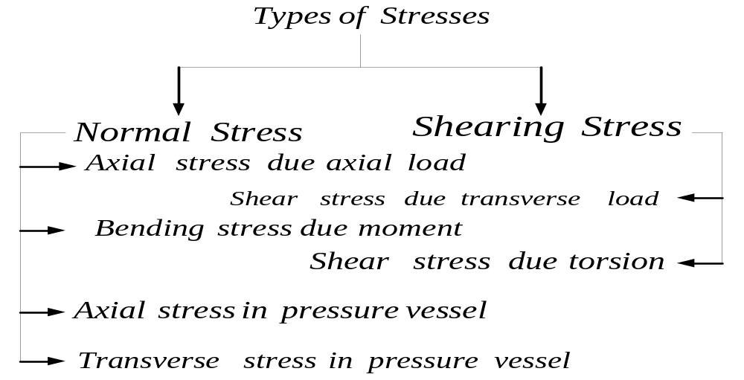

Slide 6
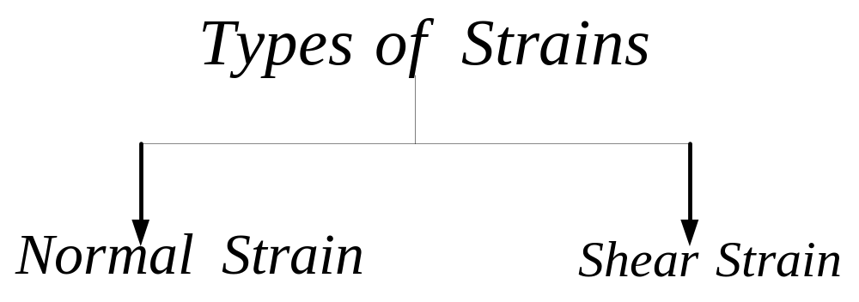
Similarly, strains can be classified and presented in the figure below.

Slide 7
Review of Moment of Area

Slide 8
Section Outline
First Moment and Centroid of an Area
First Moment and Centroid of a Composite Area
Second Moment of Area and Radius of Gyration
Parallel-Axis Theorem
Moment of Inertia of a Composite Area

Slide 9
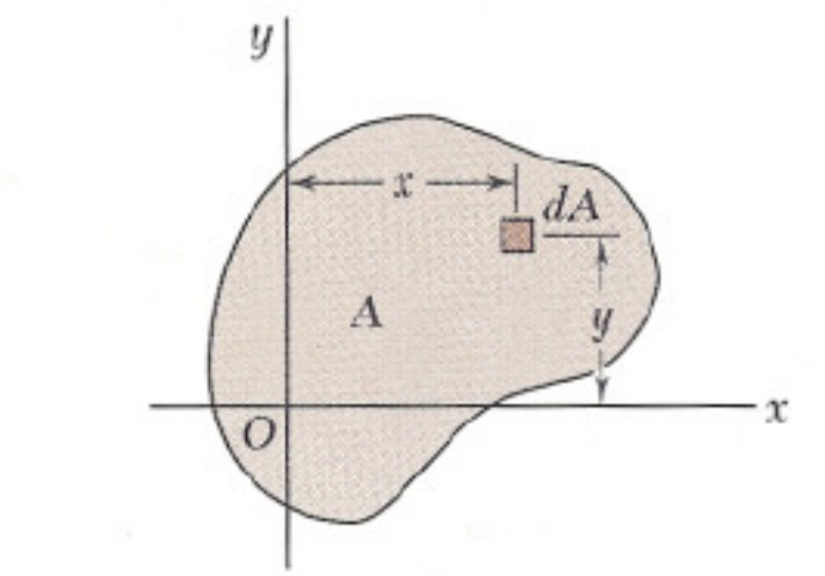
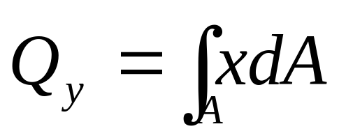
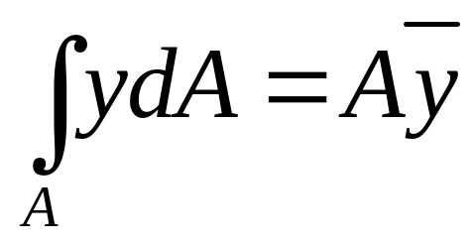
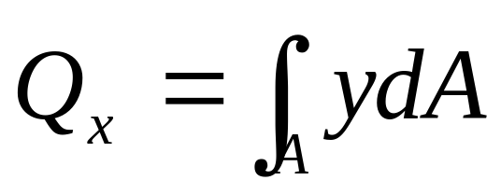
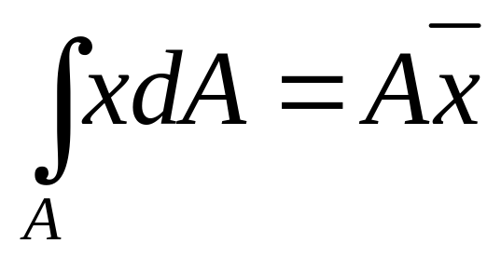
First Moment and Centroid of an Area
Consider an area A located in the xy plane as shown in Figure 1-1.
The first moment of area A about x-axis as the integral
The first moment of area A about y axis as the integral
However,

Slide 10
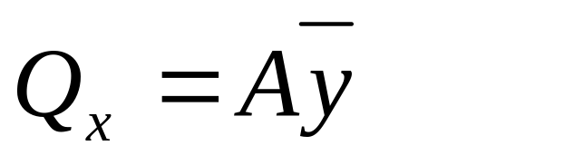
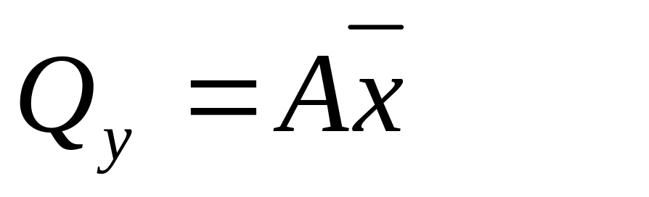
First Moment and Centroid of an Area
Comparing equations 1-1 and 1-2 with equations 1-3 and 1-4,

Slide 11
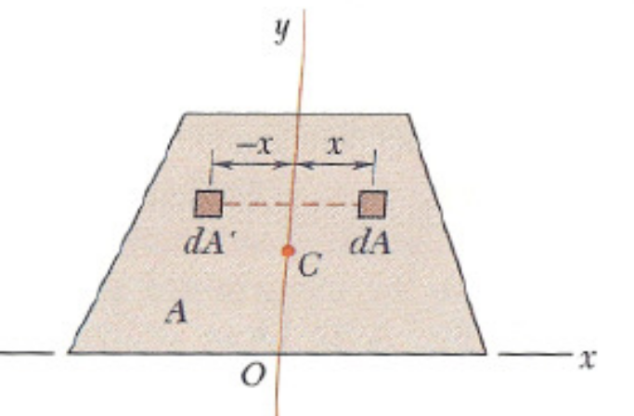
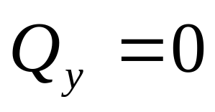
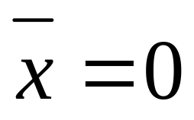
First Moment and Centroid of an Area
When an area possesses an axis of symmetry,
the first moment of area with respect to that axis is zero.
It follows that the integral in equation 2-2 is zero, that is
It also follows from the equation 1-3 that
Thus, if an area A possesses an axis of symmetry, its centroid C is located on that axis.

Slide 12
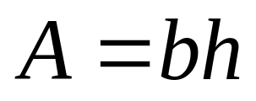
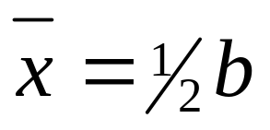
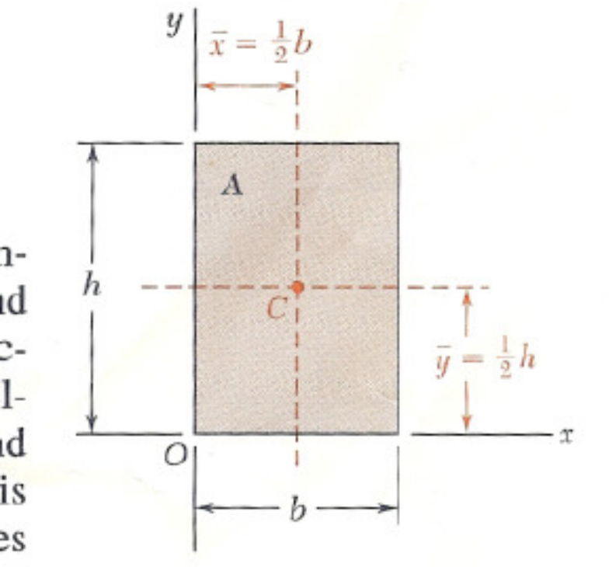
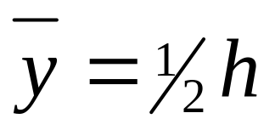
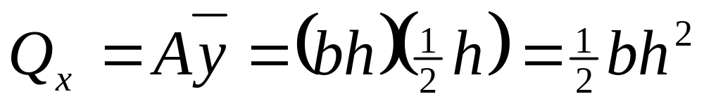
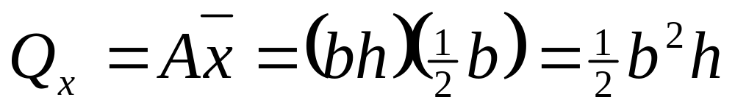
Example 1-1
Determine the first moments of area of a rectangular area as shown in Figure E1-1
Solution
We know that
Thus,
Similarly,

Slide 13
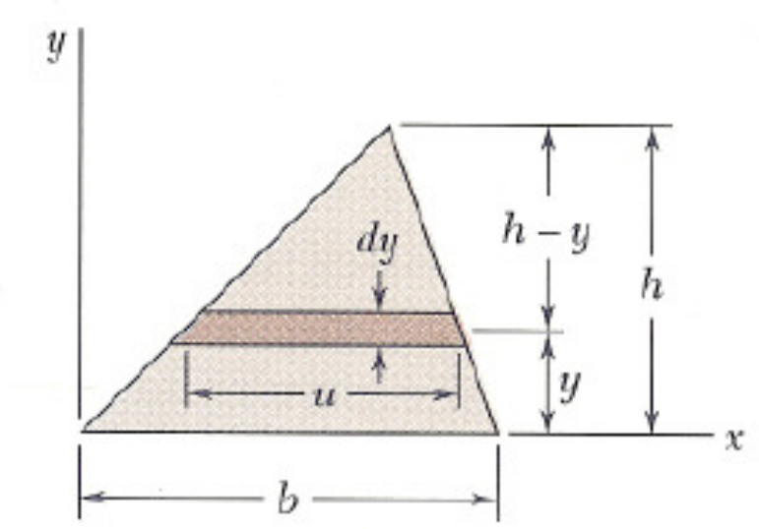

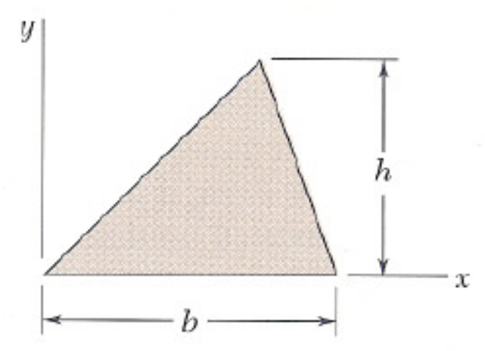
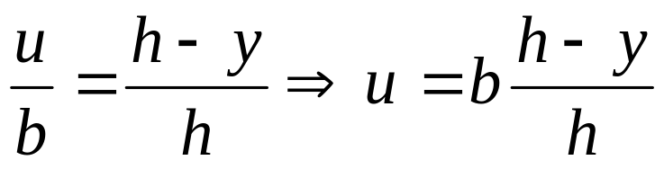
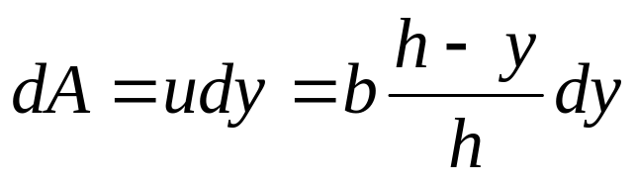
Example 1-2
For the triangular area of Figure E1-2, determine
the first moment Q_{x} of the area
the ordinate of the centroid of the area.
From similar triangles, we have
and

Slide 14
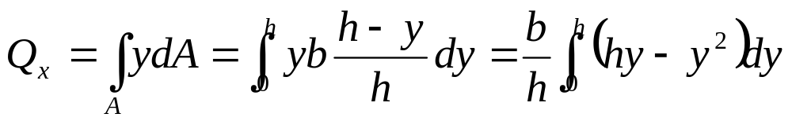
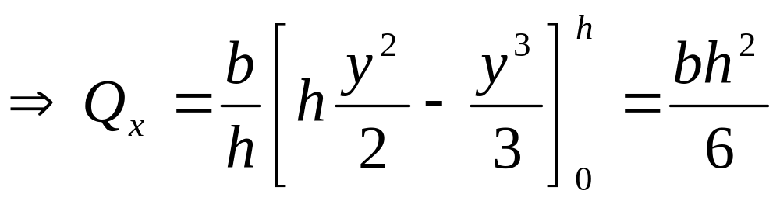
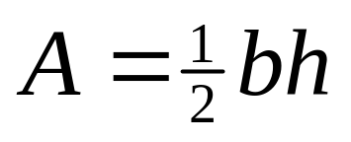
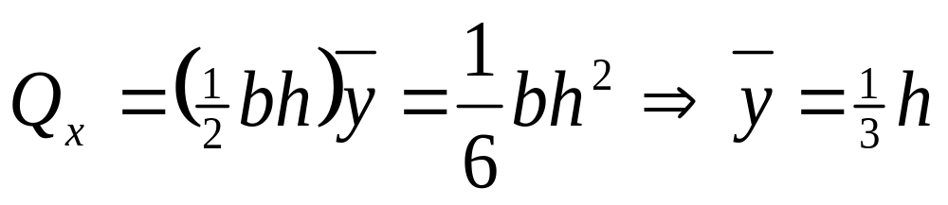

Example 1-2 Continues
The first moment of the with respect to the x-axis is
The area of a triangle is
From equation 2-5,

Slide 15
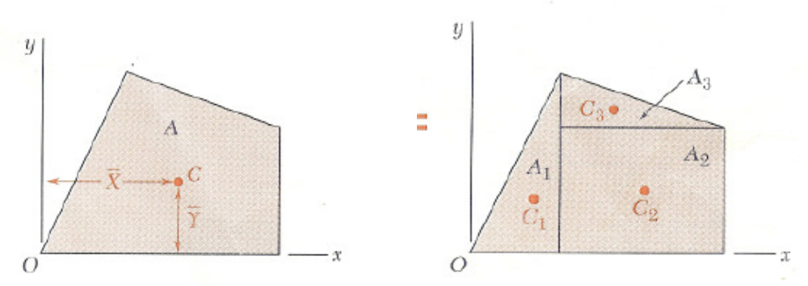




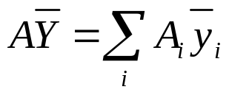
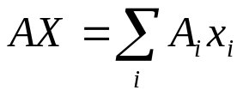
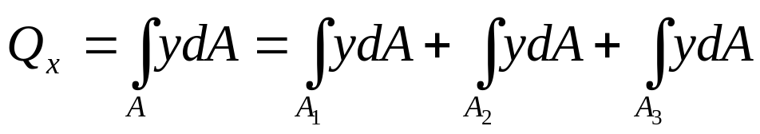
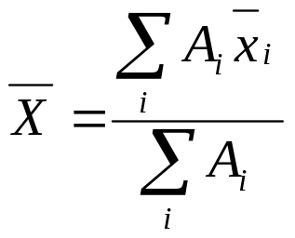
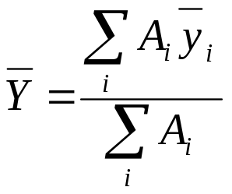
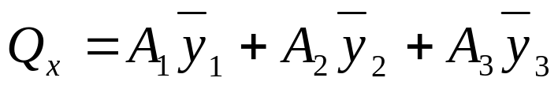
First Moment and Centroid of a Composite Area
Consider an A, such that the trapezoidal area shown in Figure 1-2 which may be divided into simple geometric shapes.

Slide 16
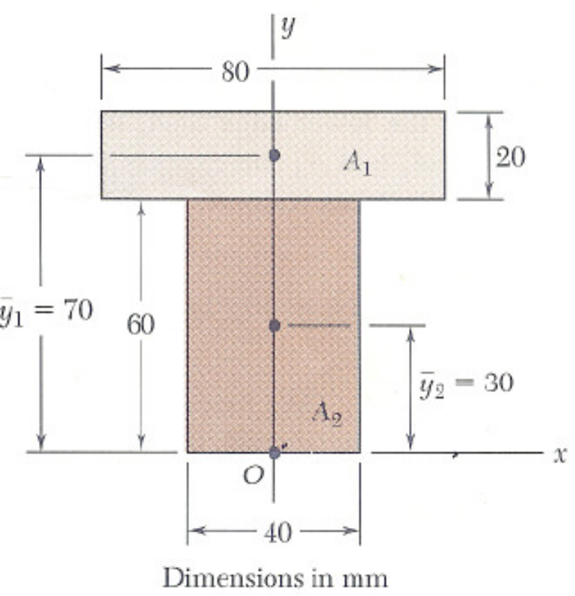
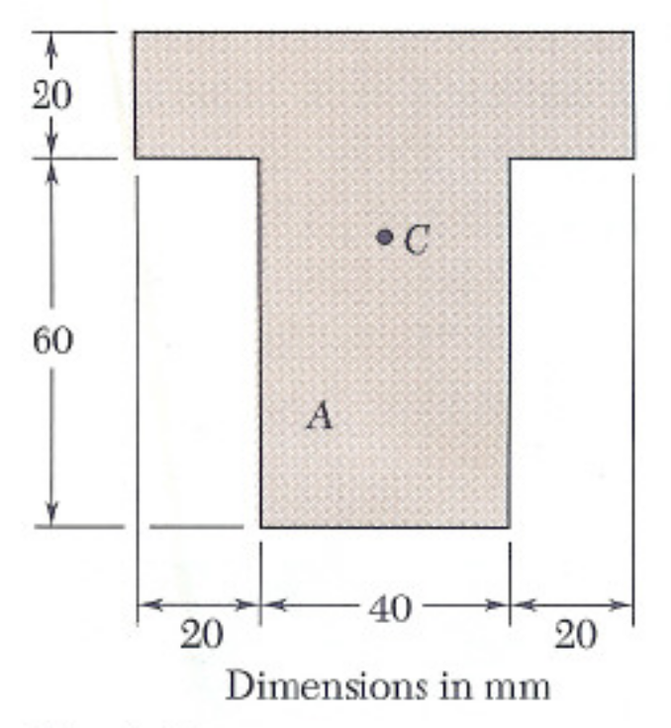

Example 1-3
Determine the first moments through the centroidal axes and hence locate the centroid C of the area A as shown in Figure E1-3.
Solution
Selecting the coordinate axes shown below, we note that the centroid C must be located on the y-axis, since this axis is an axis of symmetry, thus,

Slide 17


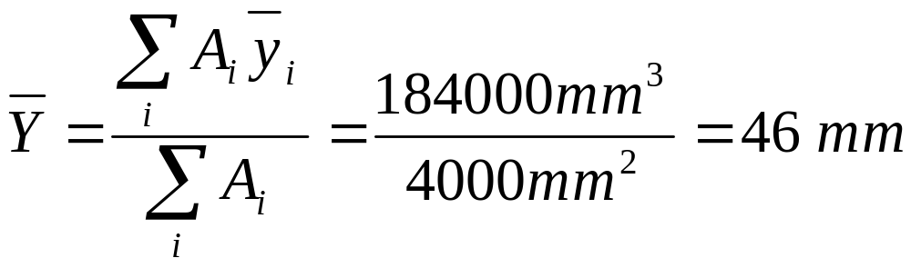
Example 1-3 Continue
 | A, mm² | mm | mm³
A₁ | 1600 | 70 | 112000
A₂ | 2400 | 30 | 72000
Summation | 4000 |  | 184000

Slide 18
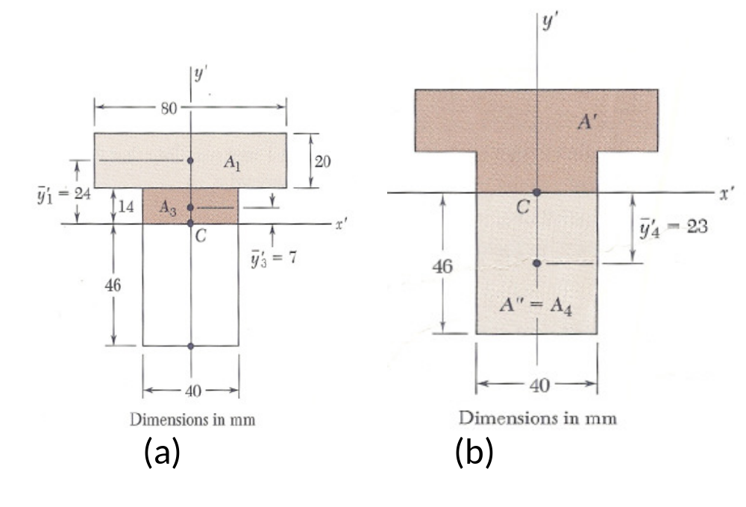
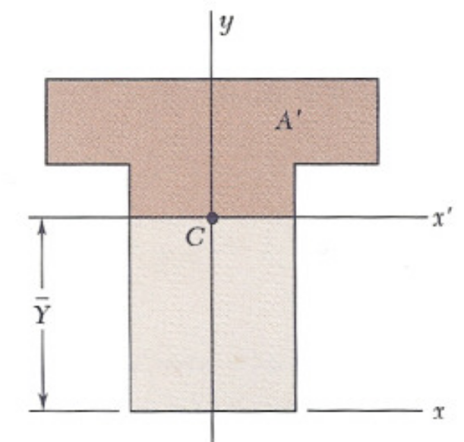
Example 1-4
Determine the first moment of A' with respect to the x' axis as shown in Figure E1-4.
Solution
Referring to the area A as in example 2-3, we consider the horizontal x' axis through its centroid C.
Such an axis is called a centroidal axis.
Denoting by A' the portion of A located above that axis as shown in Figure (a),

Slide 19
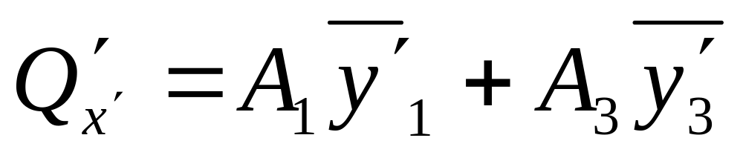
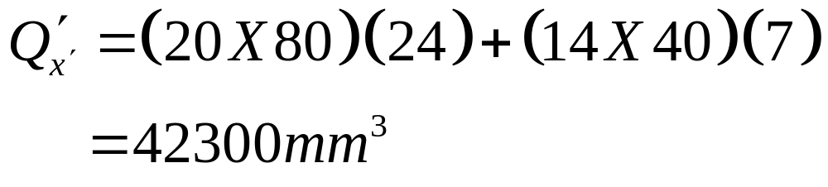
Example 1-4 Continues

Slide 20
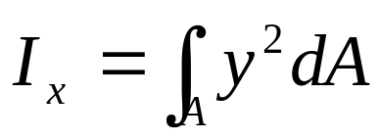
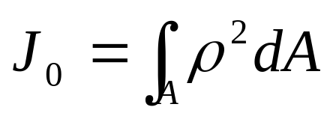
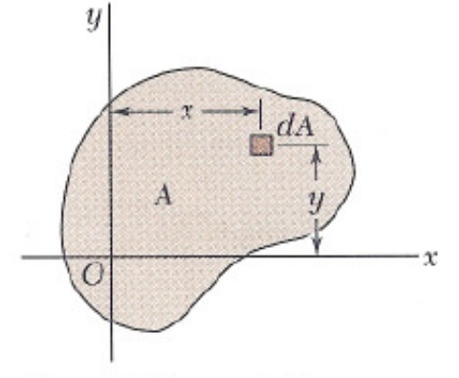
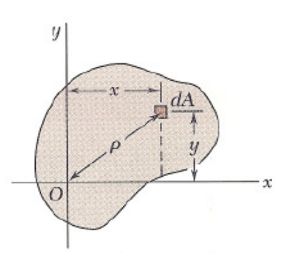
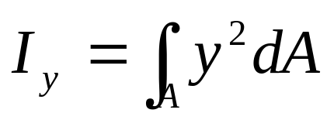
Second Moment of Area and Radius of Gyration
The second moment, or moment of inertia, of the area A with respect to the x-axis is defined
The second moment or moment of inertia, of A with respect to the y axis is defined as:
The polar moment of inertia of the area A with respect to point O as

Slide 21
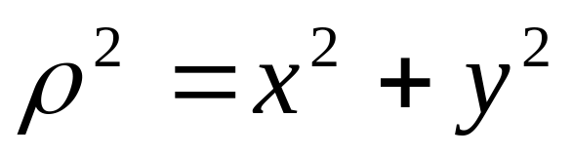
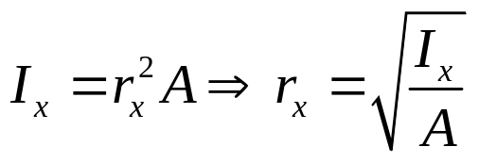
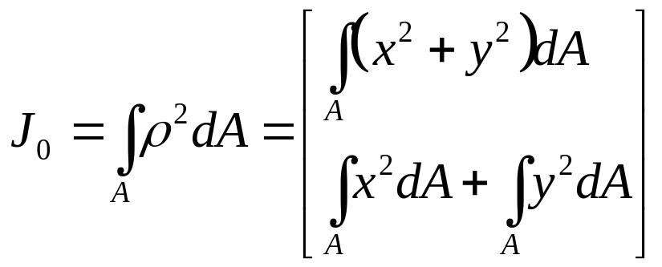
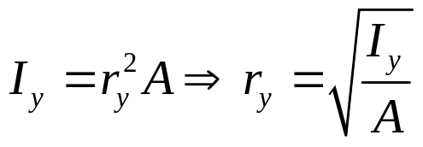
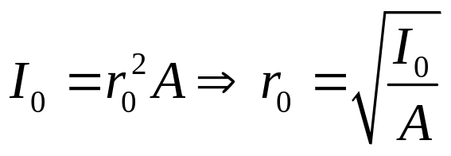


Second Moment of Area and Radius of Gyration
Noting that
we write
The radius of gyration of an area A with respect to the x axis is defined as the quantity r_{x} that satisfies the relation
Similarly
Also,
Then,

Slide 22



Example 1-5
For the rectangular area of Figure E1-5, determine
the moment of inertia I_{x} of the area with respect to the centroidal x axis,
the corresponding radius of gyration r_{x}.
Solution
a. Moment of inertia I_{x}
We select as an element of area a horizontal strip of length b and thickness dy as shown below.
Then,

Slide 23


Example 1-5 Continues
Integrating
b. Radius of Gyration r_{x}.
From equation 2-17, we have

Slide 24



Example 1-6
For the circular area of Figure E2-6, determine (a) the polar moment of inertia Jo; (b) the rectangular moment of inertia I_{x} and I_{y}.
Solution
a. Polar Moment of Inertia
We select as an element of area and ring of radius p and thickness dρ as shown in the Figure.
The polar moment of inertia of the ring is

Slide 25



Example 1-6 Continues
Integrating in p from 0 to c,
we write
b. Rectangular Moments of Inertia
Because of the symmetry of the circular area, we have I_{x} = I_{y}. Recalling equation 2-15, we write

Slide 26






Parallel-Axis Theorem
Consider the moment of inertia I_{x} of an area A with respect to an arbitrary x-axis as shown in Figure 1-11
Denoting by y the distance from an element of area dA to that axis we recall that
Denoting by y' the distance from the element dA to that axis
we write
We have, therefore,

Slide 27

Example 1-7
Determine the moment of inertia I_{x} of the area shown with respect to the centroidal x-axis as shown in Figure E1-7.
Solution
Location of centroid
The centroid C of the area must first be located.
However, this has already been done in example 1-3 for the given area.
We recall from that example hat c is located 46 mm above the lower edge of the area A.

Slide 28


Example 1.7 Continues
Rectangular area A₁
To the obtained the moment of inertia (I_{x})₁ of A₁ with respect to the x axis , we first compute the moments of inertia of A₁ using the parallel axis theorem (Eq. ), we have
Computation of Moments of Inertia
We divide the area a into the two rectangular areas A₁ and A₂ in the figure below, and compute the moments of inertia of the area with respect to the x-axis.

Slide 29



Example 1.7 Continues
Rectangular Area A₂
Computing the moments of inertia of A₂ with respect to its centroidal axis, and using the parallel axis theorem to transfer it to the x-axis we have
Entire Area A
Adding the values computed for the moments of inertia of A₁ and A₂ with respect to the x axis, we obtain the moment of inertia I_{x} of the entire area:

Slide 30

Example 1-8
Determine the centroid and the moment of inertia of the composite area in Figure E 1-8.
Figure E 2.8

Slide 31
Example 2.8 Continues
Section | Area [cm²] | $\overline{Y}$ [cm] | $\overline{Y}$A [cm³]
A | 5 x 30 = 150 | 2.5 | 375
B | 5 x 20 = 100 | 7.5 | 750
C | 5 x 10 = 50 | 12.5 | 625
Sum | 300 |  | 1750

Slide 32

Example 2-8 Continues

Slide 33
Review of Equilibrium of Rigid Bodies

Slide 34
Section Outline
Free-body Diagram
Reactions at Supports and Connections for 2D Bodies
Equilibrium Conditions Two-force body

Slide 35

Free-Body Diagram
Steps for Drawing a Free-body Diagram
Decide which body (or group of bodies) is under consideration , imagine it to be isolated from all other bodies, and sketch the outlined shape of the body.
Indicate by means of arrows all external forces and moments acting on the body. This should include (a) the weight of the body, (b) all external forces (c) reactions at supports and other contacts with other bodies.
For each unknown force, indicate its point of application and assumed a direction, if it is unknown.
Include the dimensions and angles needed for computing moments of forces and resolving forces.

Slide 36

Free-Body Diagram
The weight of a body always acts vertically downward through the centre of gravity of the body.
Forces acting at joints should considered as internal forces and should not be shown if the joint is not separated. Once the joint is separated, the forces acting at the joints must consider as external forces and indicated on the free-body diagram

Slide 37


Free-Body Diagrams
Space Diagram
A sketch showing the physical conditions of the problem.
Free-Body Diagram
A sketch showing only the forces on the selected particle.

Slide 38

Reactions at Supports and Connections for a 2D Structure
Reactions equivalent to a force with known line of action.

Slide 39


Reactions at Supports and Connections for a 2D Structure
Reactions equivalent to a force of unknown direction and magnitude.
Reactions equivalent to a force of unknown direction and magnitude and a couple of unknown magnitude

Slide 40
Equilibrium Conditions for a Particle
A particle is in equilibrium if
it is at rest relative to an initial reference frame
the body moves with constant velocity along a straight line relative to an initial frame

Slide 41



Equilibrium of a Two-Force Body
Consider a plate subjected to two forces F₁ and F₂
For static equilibrium, the sum of moments about A must be zero. The moment of F₂ must be zero.
It follows that the line of action of F₂ must pass through A.
Similarly, the line of action of F₁ must pass through B for the sum of moments about B to be zero.
Requiring that the sum of forces in any direction be zero leads to the conclusion that F₁ and F₂ must have equal magnitude but opposite sense

Slide 42


Example 1-9
A fixed crane has a mass of 1000 kg and is used to lift a 2400 kg crate. It is held in place by a pin at A and a rocker at B. The center of gravity of the crane is located at G. Determine the components of the reactions at A and B.

Slide 43


Example 1-10
The frame supports part of the roof of a small building. The tension in the cable is 150 kN. Determine the reaction at the fixed end E.

Slide 44
THANK YOU

